Slide 1

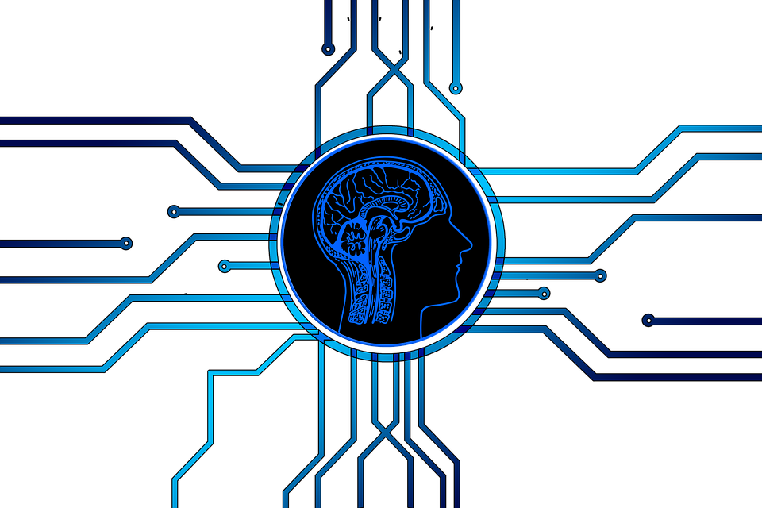
Introduction to Data Science & AI
SIT112 | Intro to Data Science & AI
Lecture Week 1– Part 2
Dr. Fatima Ansarizadeh
Lecturer in Applied AI
School of Information Technology, Deakin University
Email: f.ansarizadeh@deakin.edu.au

Slide 2

The Unit Outline
Please make sure you have visited Part 1 (The Unit Outline) …

Slide 3
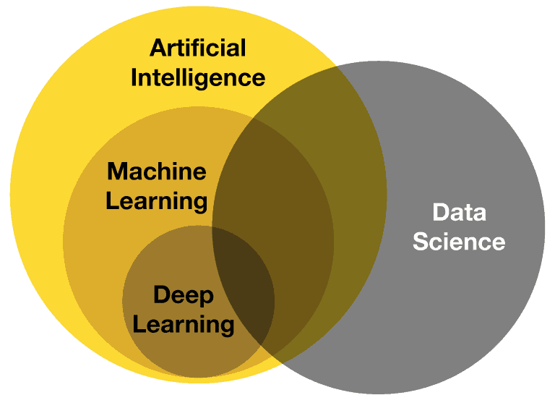
Content
What is Artificial Intelligence (AI)?
Foundations of AI
The Risks of using (misusing) AI
Human-Centered AI
Machine Learning
Natural Language Processing (NLP)
What is Data Science?
Before Data Analysis
The 5 Phases of Data Analysis
Python for Data Science and AI
JupyterLab
https://www.deviq.io/

Slide 4
What is Artificial Intelligence?
Definition of Intelligence:
Intelligence as ﬁdelity to human performance.
An abstract, formal deﬁnition of intelligence called rationality —loosely speaking, doing the “right thing.”
The subject matter itself also varies:
Some consider Intelligence a property of internal thought processes and reasoning (thinking intelligently).
Others focus on Intelligence as an external characterisation (acting intelligently).

Slide 5

What is Artificial Intelligence? (Cont.)
Two approaches:
The pursuit of human-like intelligence must be in part an empirical science related to psychology, involving observations and hypotheses about actual human behavior and thought processes;
A rationalist approach, on the other hand, involves a combination of mathematics and engineering, and connects to statistics, control theory, and economics.

Slide 6
What is Artificial Intelligence? (Cont.)
Four possible definitions for AI:
Thinking Humanly
Acting Humanly
Thinking Rationally
Acting Rationally

Slide 7
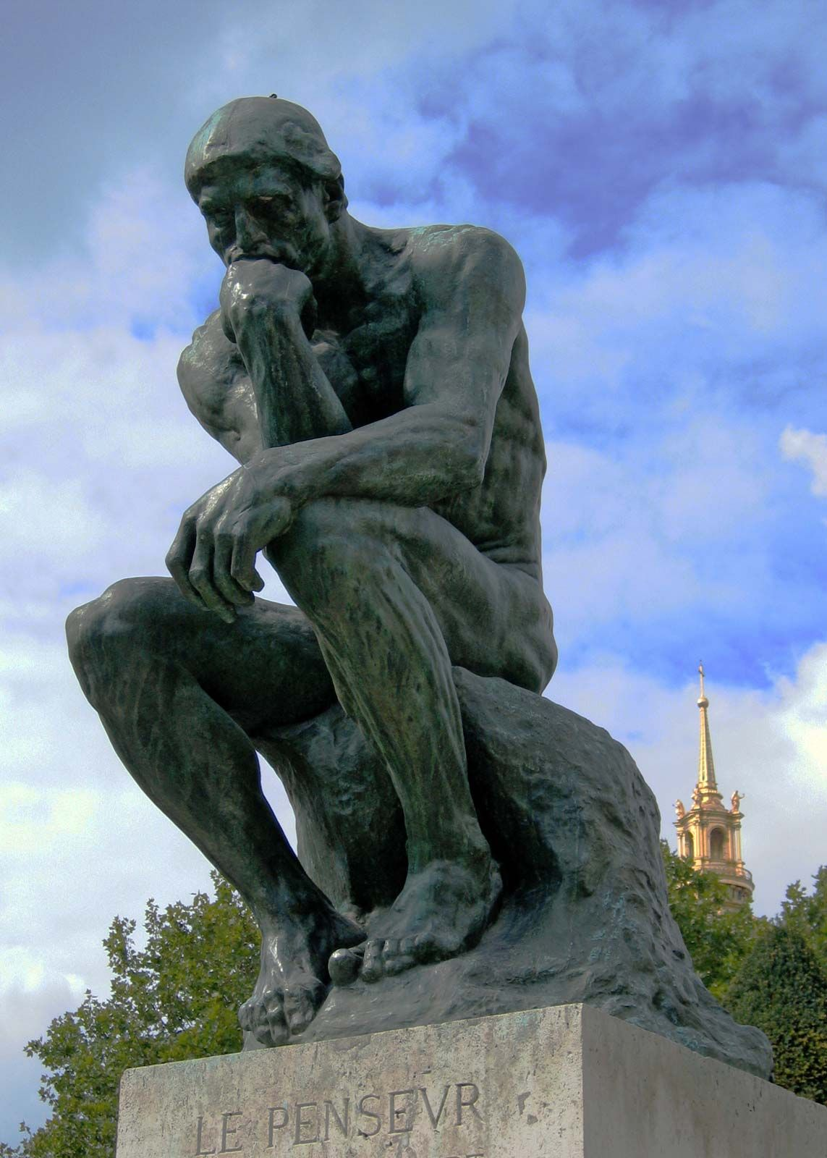
What is Artificial Intelligence? Thinking Humanly; Cognitive Modeling
To say that a program thinks like a human, we must know how humans think. We can learn about human thought in three ways:
Introspection —trying to catch our own thoughts as they go by;
Psychological experiments —observing a person in action;
Brain imaging —observing the brain in action.
The interdisciplinary ﬁeld of cognitive science brings together computer models from AI and experimental techniques from psychology to construct theories of the human mind.
Notes:
Intelligence = ability to behave like a human

Slide 8
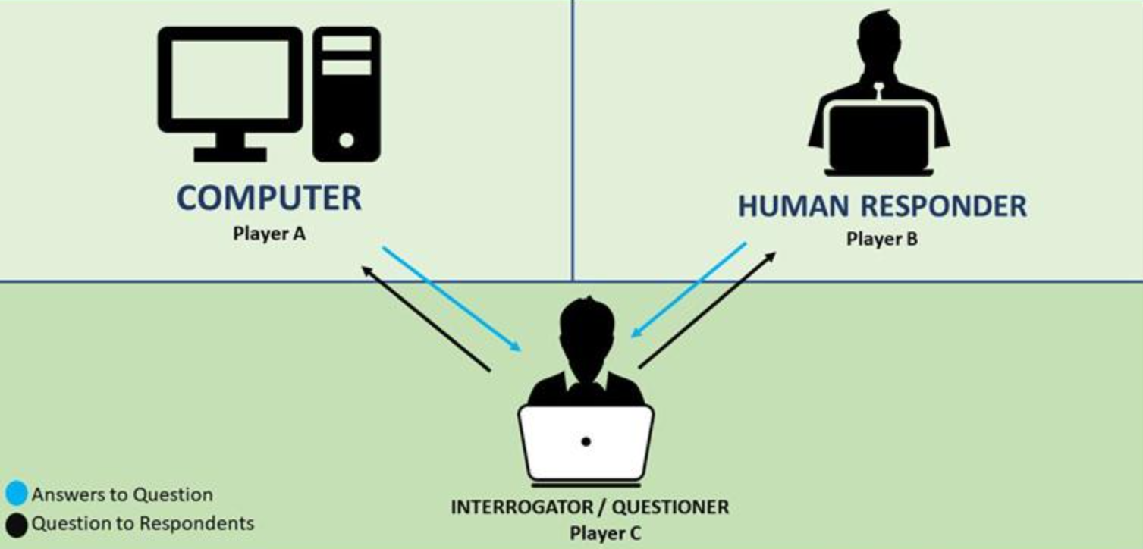
What is Artificial Intelligence? Acting Humanly; The Turing Test
Turing test is passed if a human interrogator cannot tell whether the written responses come from a person or from a computer. The computer would need:
Natural language processing to communicate successfully;
Knowledge representation to store what it knows or hears;
Automated reasoning to answer questions and to draw conclusions;
Machine learning to adapt to new circumstances and to detect and extrapolate patterns.
Total Turing test requires interaction with objects in the real world, hence the need for:
Computer vision and speech recognition to perceive the world;
Computer robotics to manipulate objects.
Notes:
The Turing Test was proposed by Alan Turing in 1950. It is a way to determine whether a machine can exhibit human-like intelligence.
There are three participants: A human judge
A human participant
A machine (AI system)
The judge communicates with both (usually via text, not face-to-face). The judge’s goal: 👉 Figure out which one is the human. If the judge cannot reliably tell the difference, the machine is said to have passed the Turing Test.
The test doesn’t check how the AI works internally. Instead, it focuses on behavior:
If a machine behaves like a human in conversation, it can be considered intelligent.
Why it matters
It was the first practical definition of AI
It shifted focus from “thinking” → “acting like a human”
It still influences AI research and debates today
Limitations (important for your AI teaching)
Passing ≠ true understanding
AI can fake human-like responses
It measures imitation, not real intelligence

Slide 9
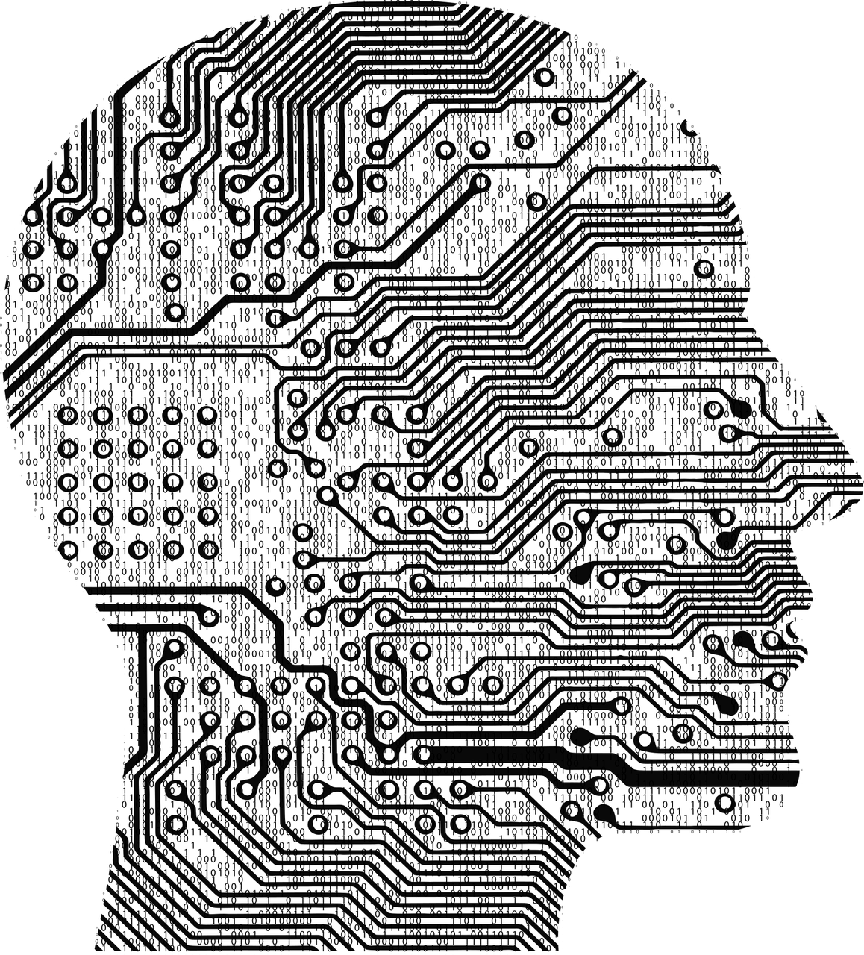
What is Artificial Intelligence? Thinking Rationally; “Laws of Thought”
Attempts to codify “right thinking”— that is, irrefutable reasoning processes.
Laws of thought: patterns for argument structures that always yield correct conclusions when given correct premises.
Socrates is a man & all men are mortal -> Socrates is mortal.
The logicist tradition in artiﬁcial intelligence hopes to build on laws of thought (logic) to create intelligent systems.
Logic requires knowledge of the world that is certain — a condition that, in reality, is seldom achieved. We don’t know the rules of, say, politics or warfare in the same way that we know the rules of chess or arithmetic.
The theory of probability ﬁlls this gap, allowing rigorous reasoning with uncertainty.

Slide 10
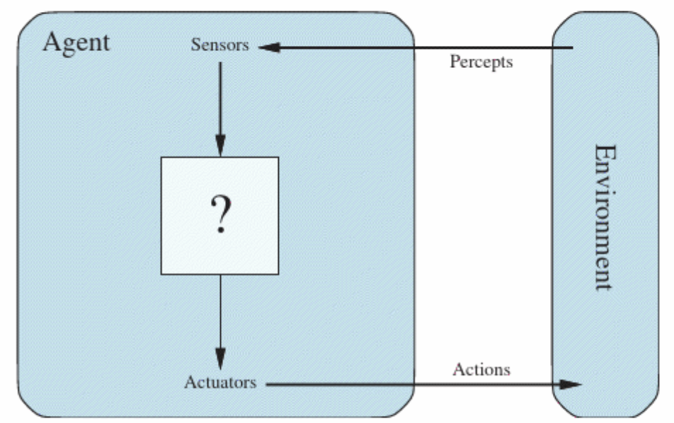
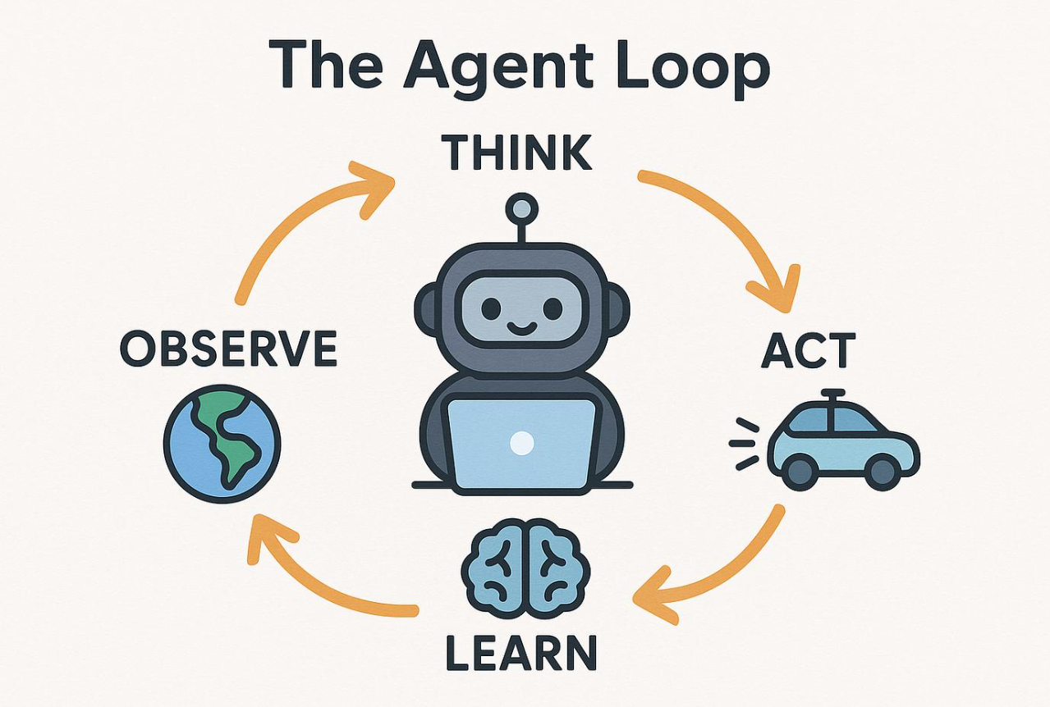
What is Artificial Intelligence? Acting Rationally; “Rational Agent”
In the “laws of thought” approach to AI, the emphasis was on correct inferences.
Making correct inferences is sometimes part of being a rational agent, because one way to act rationally is to deduce that a given action is best and then to act on that conclusion.
On the other hand, there are ways of acting rationally that cannot be said to involve inference. For example, recoiling from a hot stove is a reﬂex action that is usually more successful than a slower action taken after careful deliberation.
Notes:
A rational agent is simply something that: 👉 chooses the best possible action based on what it knows.
Thinking vs Acting
“In early AI, people believed intelligence meant: 👉 thinking correctly — making logical, perfect inferences.
That’s what we call the ‘laws of thought’ approach.”
Rational ≠ always thinking deeply
“But here’s the important part highlighted on the slide:
👉 Being rational does NOT always mean doing complex reasoning.
Sometimes:
Yes, we think carefully and make decisions
But other times, fast reactions are actually better
Example (very important for students)
“Imagine you touch a hot stove 🔥”
You immediately pull your hand away
You don’t stop and think:
‘Let me logically infer whether this is dangerous…’
👉 That reaction is rational, even though:
No deep reasoning happened
It was automatic
What this means in AI
“So in AI, we don’t judge intelligence by: ❌ how much the system ‘thinks’ ✅ but by how well it acts to achieve a goal
This diagram shows a rational agent loop:
👁️ Sensors → observe the environment
🧠 Agent → decides what to do
⚙️ Actuators → take action
🌍 Environment changes
👉 Then the cycle repeats
“A rational agent is not the one that thinks the most… it’s the one that acts in the best possible way.”

Slide 11
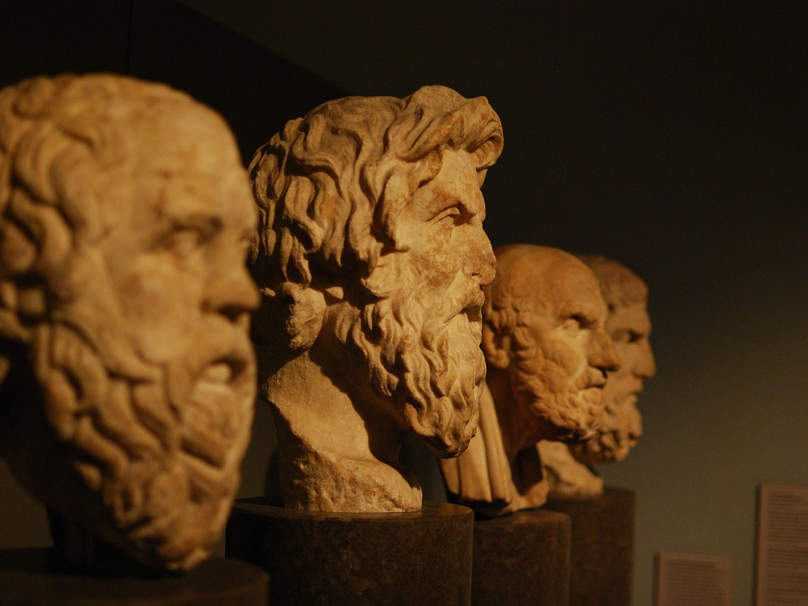
Foundations of AI: Philosophy
Can formal rules be used to draw valid conclusions?
Does the mind arise from a physical brain? If so, how?
Where does knowledge come from?

Slide 12
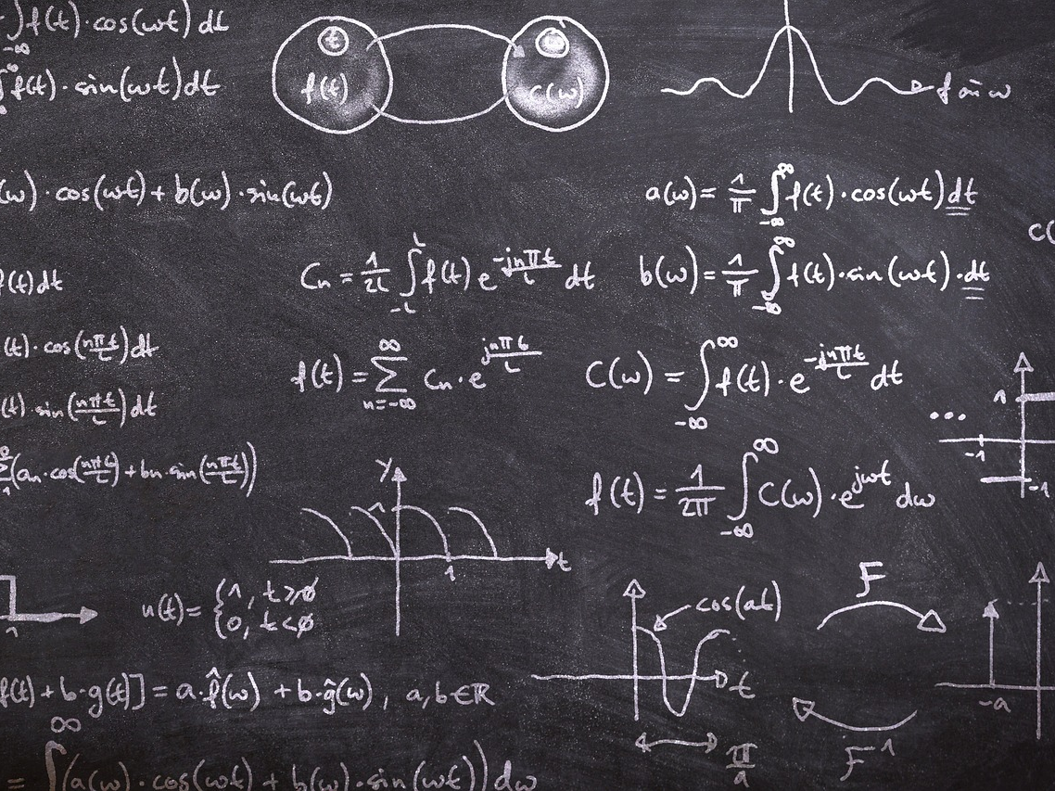
Foundations of AI: Mathematics
What are the formal rules to draw valid conclusions?
What can be computed?
How do we reason with uncertain information?

Slide 13

Foundations of AI: Economics
How should we make decisions in accordance with our preferences?
How should we do this when others may not go along?
How should we do this when the payoff may be far in the future?
It’s not just about money, it includes both monetary and non-monetary values.

Slide 14
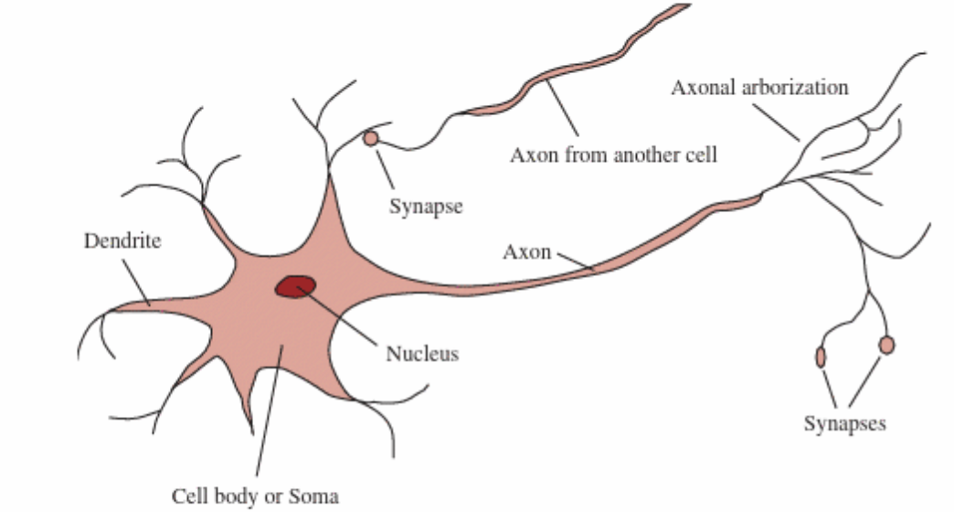
Foundations of AI: Neuroscience
How does brain process information?

Slide 15
Foundations of AI: Other Disciplines
Psychology: How do humans think and act?
Linguistics: How does language relate to thought?
Computer Engineering: How to build efficient computers?
Control Theory and Cybernetics: How can artifacts operate under their own control?
Notes:
Cybernetics is the study of how systems control, communicate, and regulate themselves using feedback.
Simple intuition
Think of a thermostat:
It measures room temperature
Compares it to a desired value
Adjusts heating automatically
That loop is called feedback — the heart of cybernetics.
Why it matters in AI (important for your teaching)
Early foundation of AI and machine learning
Introduced the idea of learning from feedback
Influences modern concepts like:
Reinforcement learning
Adaptive systems
Self-regulation
Cybernetics = how systems use feedback to control themselves and improve behavior

Slide 16

The Risks of using (misusing) AI
We incur risks from AI, inadvertent or otherwise. E.g.,
Risk of lethal autonomous weapons : These are deﬁned by the UN as weapons that can locate, select, and eliminate human targets without human intervention.
Risk of surveillance and persuasion : While it is expensive, tedious, and sometimes legally questionable for security personnel to monitor phone lines, video camera feeds, emails, and other messaging channels, AI (speech recognition, computer vision, and natural language understanding) can be used for mass surveillance.
Risk of biased decision making : Careless or deliberate misuse of machine learning algorithms for tasks such as evaluating parole and loan applications can result in decisions that are biased by race, gender, or other protected categories. Often, the data themselves reﬂect bias in society.

Slide 17
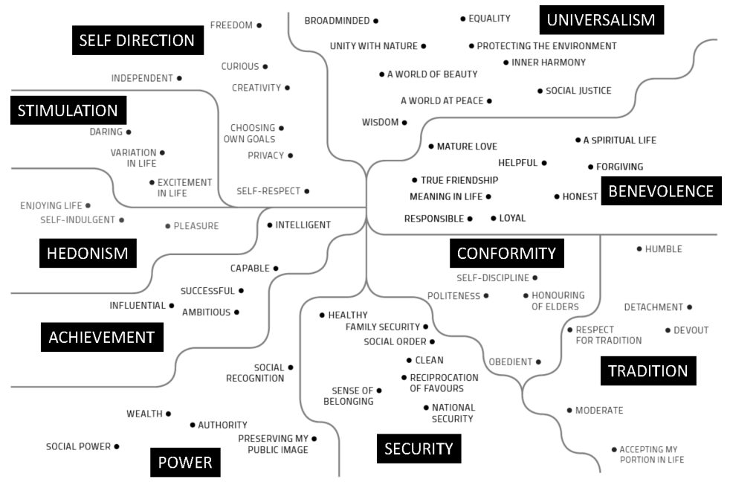
Human-Centered AI: Human Values

Slide 18
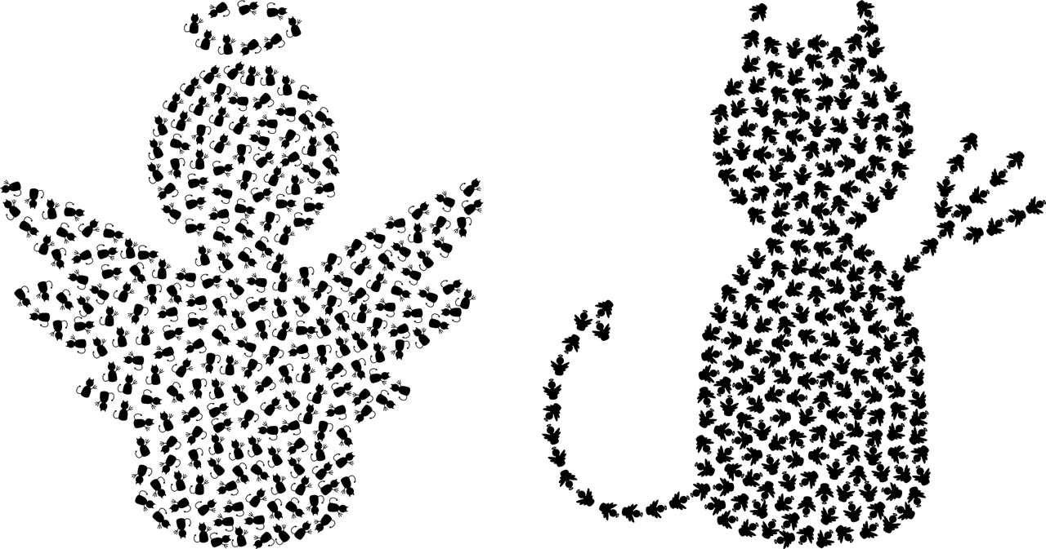
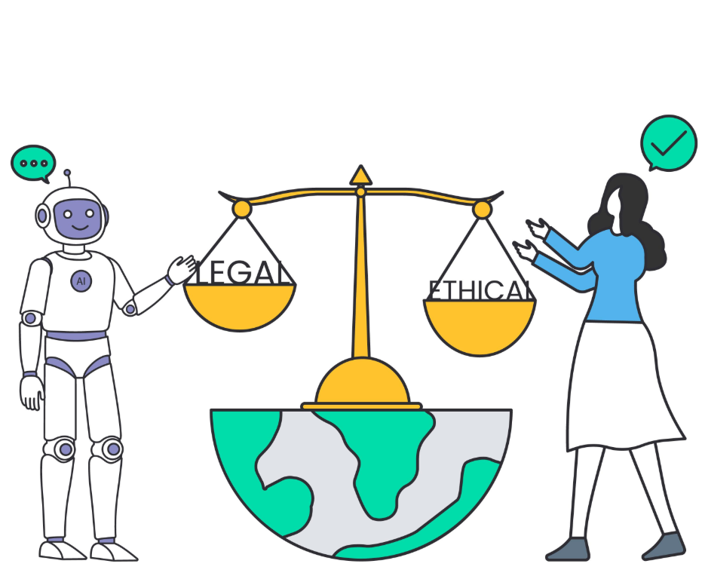
Human-Centered AI: Ethical Principles
Transparency: Ensuring AI systems and their decisions can be understood by users and stakeholders.
Fairness and Non-discrimination: Preventing AI from perpetuating or exacerbating biases and inequalities.
Privacy and Data Protection: Safeguarding personal information processed by AI systems.
Accountability and Responsibility: Establishing clear accountability for AI decisions and actions.

Slide 19
Human-Centered AI: Strategies for Ethical AI
Inclusive Design: Engaging diverse groups in AI development to reflect a wide range of human values and perspectives.
Ethical AI Governance: Developing and enforcing guidelines, policies, and regulations to guide ethical AI development and use.
Continuous Monitoring: Regularly assessing AI systems for ethical compliance and societal impact.

Slide 20
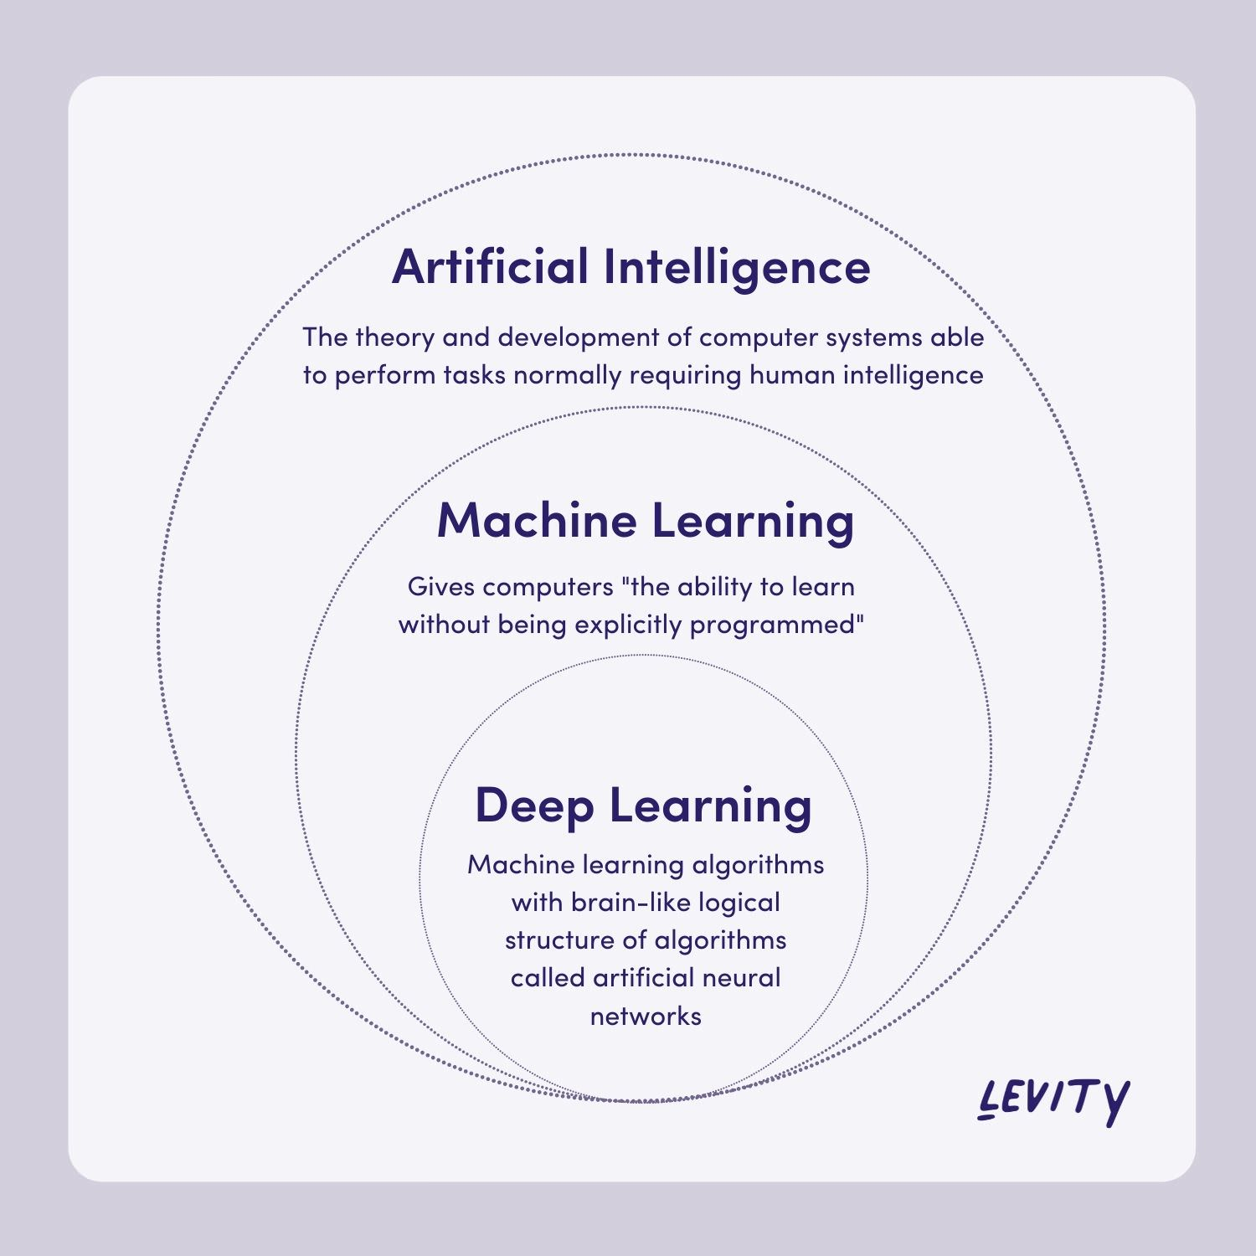
Machine Learning
https://levity.ai/

Slide 21

Machine Learning
Notes:
https://www.youtube.com/watch?v=f_uwKZIAeM0

Slide 22
Machine Learning: Supervised Learning
Models that can predict labels based on labelled training data.
Classification: Models that predict labels as two or more discrete categories.
Email spam classification: Given an email, classify it as either spam or not spam.
Image classification: Given an image, classify it into one of several categories, such as dogs, cats, birds, etc.
Regression: Models that predict continuous values.
House price prediction: Given a set of features such as the number of bedrooms, bathrooms, square footage, etc., predict the selling price of a house.
Stock price prediction: Given historical stock prices, predict the future stock prices.

Slide 23
Machine Learning: Unsupervised Learning
Models that identify structure in unlabeled data:
Clustering: Models that detect and identify distinct groups in the data
Customer segmentation: To segment customers into groups based on similarities in their behaviour, preferences, demographics, or purchase history.
Image segmentation: To identify different objects in an image, such as cars, people, or animals. This can be useful for tasks like object recognition, image search, or autonomous driving.
Dimensionality reduction: Models that detect and identify lower-dimensional structure in higher-dimensional data
Face recognition: To extract the most important features from images to recognise faces. For example, Principal Component Analysis (PCA) can be used to reduce the dimensionality of facial images.
Sentiment analysis: To extract the most important features from text to perform sentiment analysis. For example, Singular Value Decomposition (SVD) can be used to reduce the dimensionality of a document-term matrix.

Slide 24

Natural Language Processing: What is NLP?
Enables computers to understand, interpret, and generate human languages.
Core Objectives:
Understanding: Extract meaning from human language.
Interaction: Enable seamless communication between humans and machines.
Generation: Produce human-like responses and texts.
Main Components:
Syntax Analysis: Grammar, sentence structure.
Semantic Analysis: Meaning of words and sentences.
Pragmatics: Context and situational understanding.

Slide 25
Natural Language Processing: Key Challenges
Ambiguity in language interpretation.
Contextual nuances and cultural differences.
Sarcasm, irony, and humor understanding.

Slide 26
What is Data Science?
https://www.deviq.io/

Slide 27
What is Data Science? There are Different Definitions
Data science is an emerging discipline. It remains a science where new knowledge and tools are still being invented.
There is not yet a clear definition agreed by all for the term ‘data science’. Different definitions exist from different perspectives (government, business, research, etc.)

Slide 28
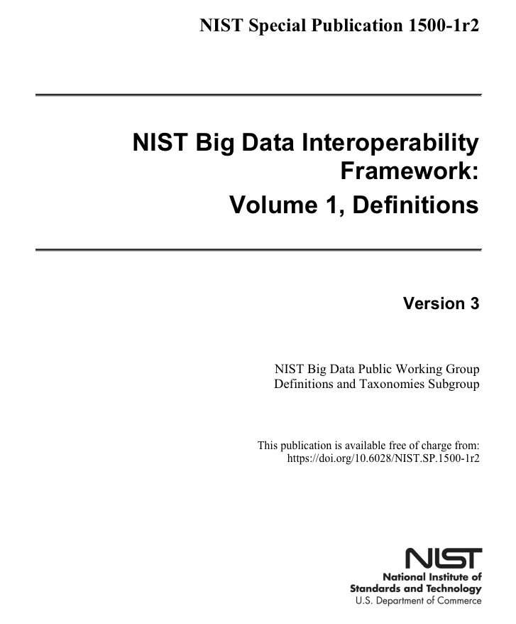
What is Data Science? NIST’s definition
NIST’s definition: “Data science is the methodology for the synthesis of useful knowledge directly from data through a process of discovery or of hypothesis formulation and hypothesis testing.”

Slide 29
Who is Data Scientist? NIST Definition
NIST definition: “A data scientist is a practitioner who has sufficient knowledge in the overlapping regimes of business needs, domain knowledge, analytical skills, and software and systems engineering to manage the end-to-end data processes in the analytics life cycle.”

Slide 30
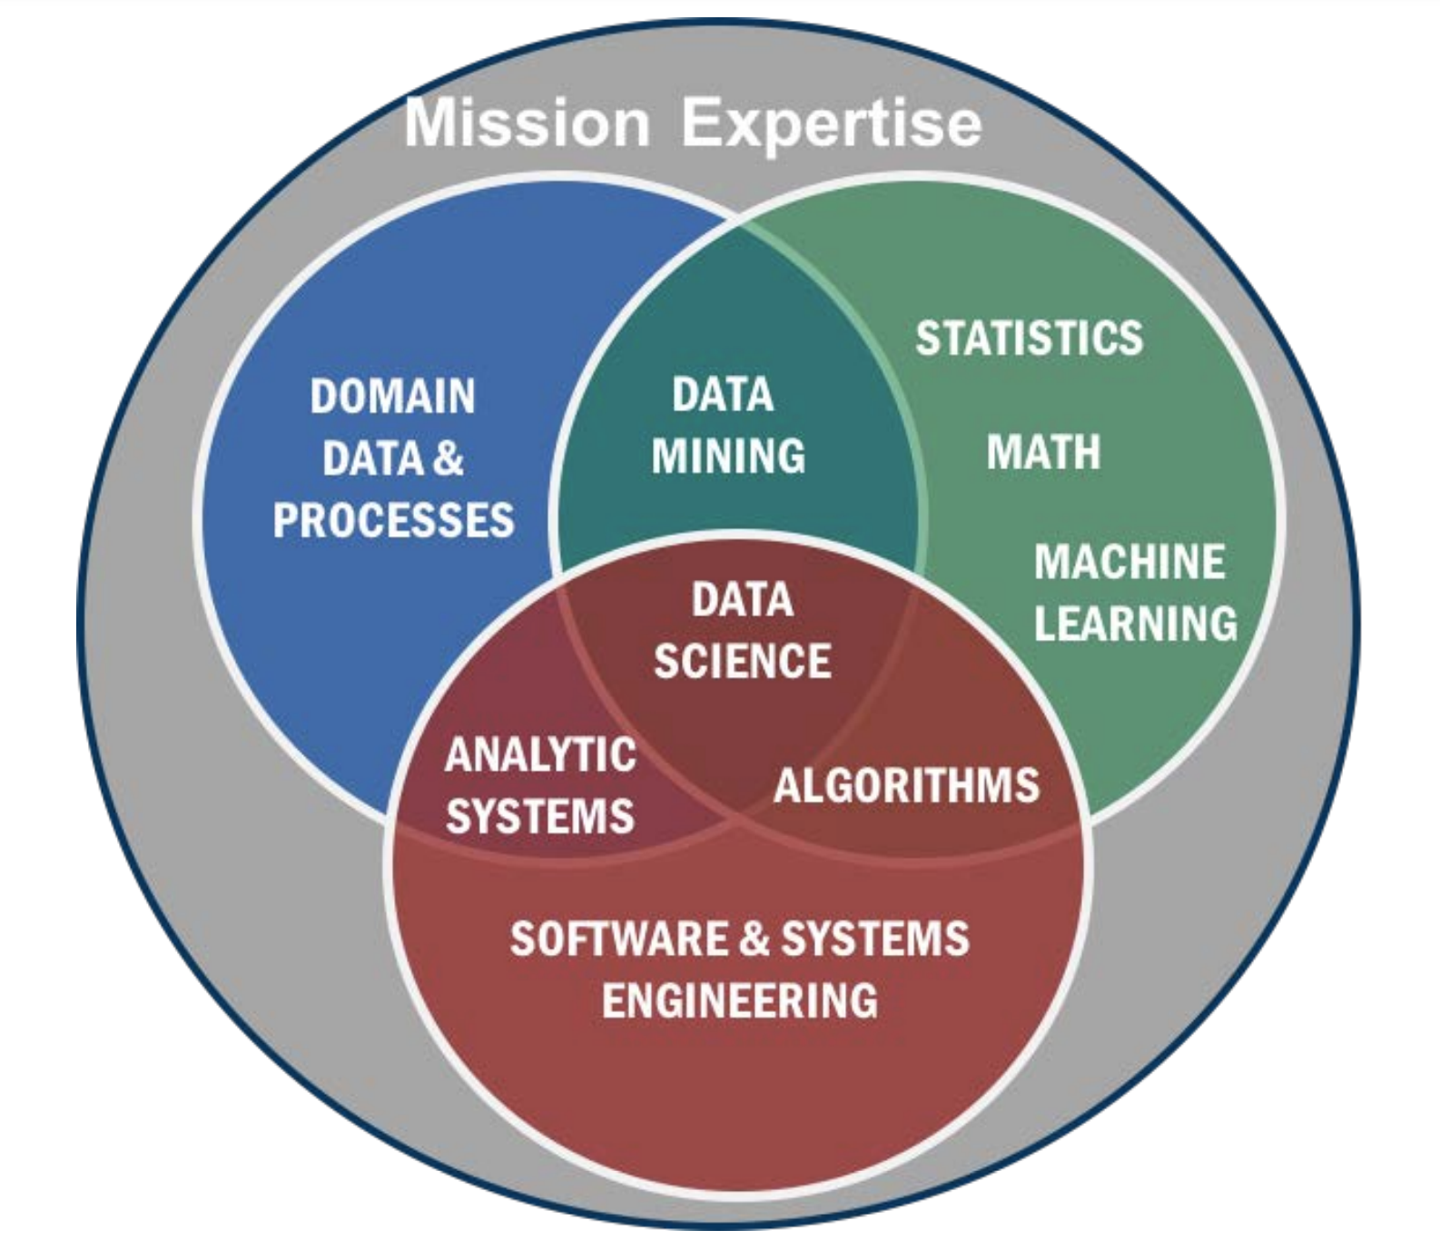
Data Science is Interdisciplinary …
https://doi.org/10.6028/NIST.SP.1500-1r2

Slide 31

Our Focus
The synergies between Data Science & AI as interdisciplinary domains of knowledge and skill sets.
Analyzing textual data

Slide 32
Before Data Analysis: Define Your Audience
If you’re presenting your findings to other people, like managers or clients, you also need to define your target audience before you start your analysis. This helps you tailor your analysis and presentation to their specific needs and interests.
Managers may be more interested in high-level insights and strategic recommendations than in detailed technical explanations.
Clients may be more interested in how your analysis can help them solve specific problems or achieve specific goals. They may also be more interested in interactive tools that allow them to explore the data themselves.
By defining your target audience, you can also anticipate potential objections or questions they may have and address them proactively in your analysis and presentation. This can help build credibility and trust with your audience.

Slide 33
Data Analysis: Phase 1. Get the Data
Refers to the process of collecting and acquiring data for analysis.
Involves identifying and gathering relevant data from various sources, such as databases, APIs, web scraping, surveys, or experiments.
It also involves documenting the data sources, which is important for transparency, reproducibility, and data governance; it can help ensure the analysis is valid and trustworthy.

Slide 34
Data Analysis: Phase 2. Clean the Data
Focuses on identifying and correcting errors and inconsistencies in the data:
Remove unnecessary rows and columns: This involves eliminating the rows or columns in the dataset that are not relevant or useful for the analysis, which can improve processing speed and reduce noise in the data.
Handle invalid or missing values: This involves identifying and addressing missing or invalid data values in the dataset, which can impact the accuracy and reliability of the analysis. Common approaches to handling missing or invalid values include deletion, substitution, or imputation (estimating the values by preserving the statistical relationships).
Change object data types to datetime or numeric data types: Converting data stored in object (text) format into datetime or numeric formats, such as integers, floats, or timestamps, is necessary for many analysis techniques that require specific data formats.

Slide 35
Data Analysis: Phase 3. Prepare the Data
Add columns that are derived from other columns: This involves creating new columns in a dataset based on the values of other columns, using mathematical calculations or data transformations to extract more meaningful information.
Shape the data into the forms that are needed for your analysis: This involves structuring the data in a way that makes it easier to analyse, including filtering, sorting, and grouping the data to focus on relevant information.
Make preliminary visualisations to better understand the data: This involves creating graphs, charts, and other visual representations of the data to explore its patterns and relationships, and to identify any outliers or anomalies that may need further investigation.

Slide 36
Data Analysis: Phase 4. Analyze the Data
Get new views of the data by grouping and aggregating the data: This involves summarizing the data by creating subsets based on specific variables and then applying aggregation functions such as sum, average, or count to calculate summary statistics for each group.
Make visualisations that provide insights and show relationships: This involves creating charts, graphs, and other visual representations of the data to identify patterns, trends, and relationships that may not be apparent in raw data.
Model the data as part of predictive analysis: This involves building statistical models, such as regression or decision trees, to predict future outcomes based on historical data and to identify the key factors that drive those outcomes.

Slide 37
Data Analysis: Phase 5. Visualize the Data
Enhancing visualizations to make them appropriate for the target audience.
Involves tailoring the presentation of data to effectively communicate insights and key messages to a specific group of people. This can include modifying the design, layout, and level of detail of the visualisation to match the audience's level of expertise, interests, and preferences.
For example, a simple and intuitive visualisation may be more suitable for a non-technical audience, while a more complex and detailed visualization may be more appropriate for a group of data experts.

Slide 38

What’s the difference between data cleaning and data preparation?
Answer …

Slide 39
What’s the difference between data cleaning and data preparation?
Data cleaning focuses on identifying and correcting errors and inconsistencies in the data, while data preparation focuses on transforming and formatting the data to make it suitable for analysis.
Both steps are important in the data analysis process, as they help to ensure that the results of the analysis are accurate and meaningful.

Slide 40
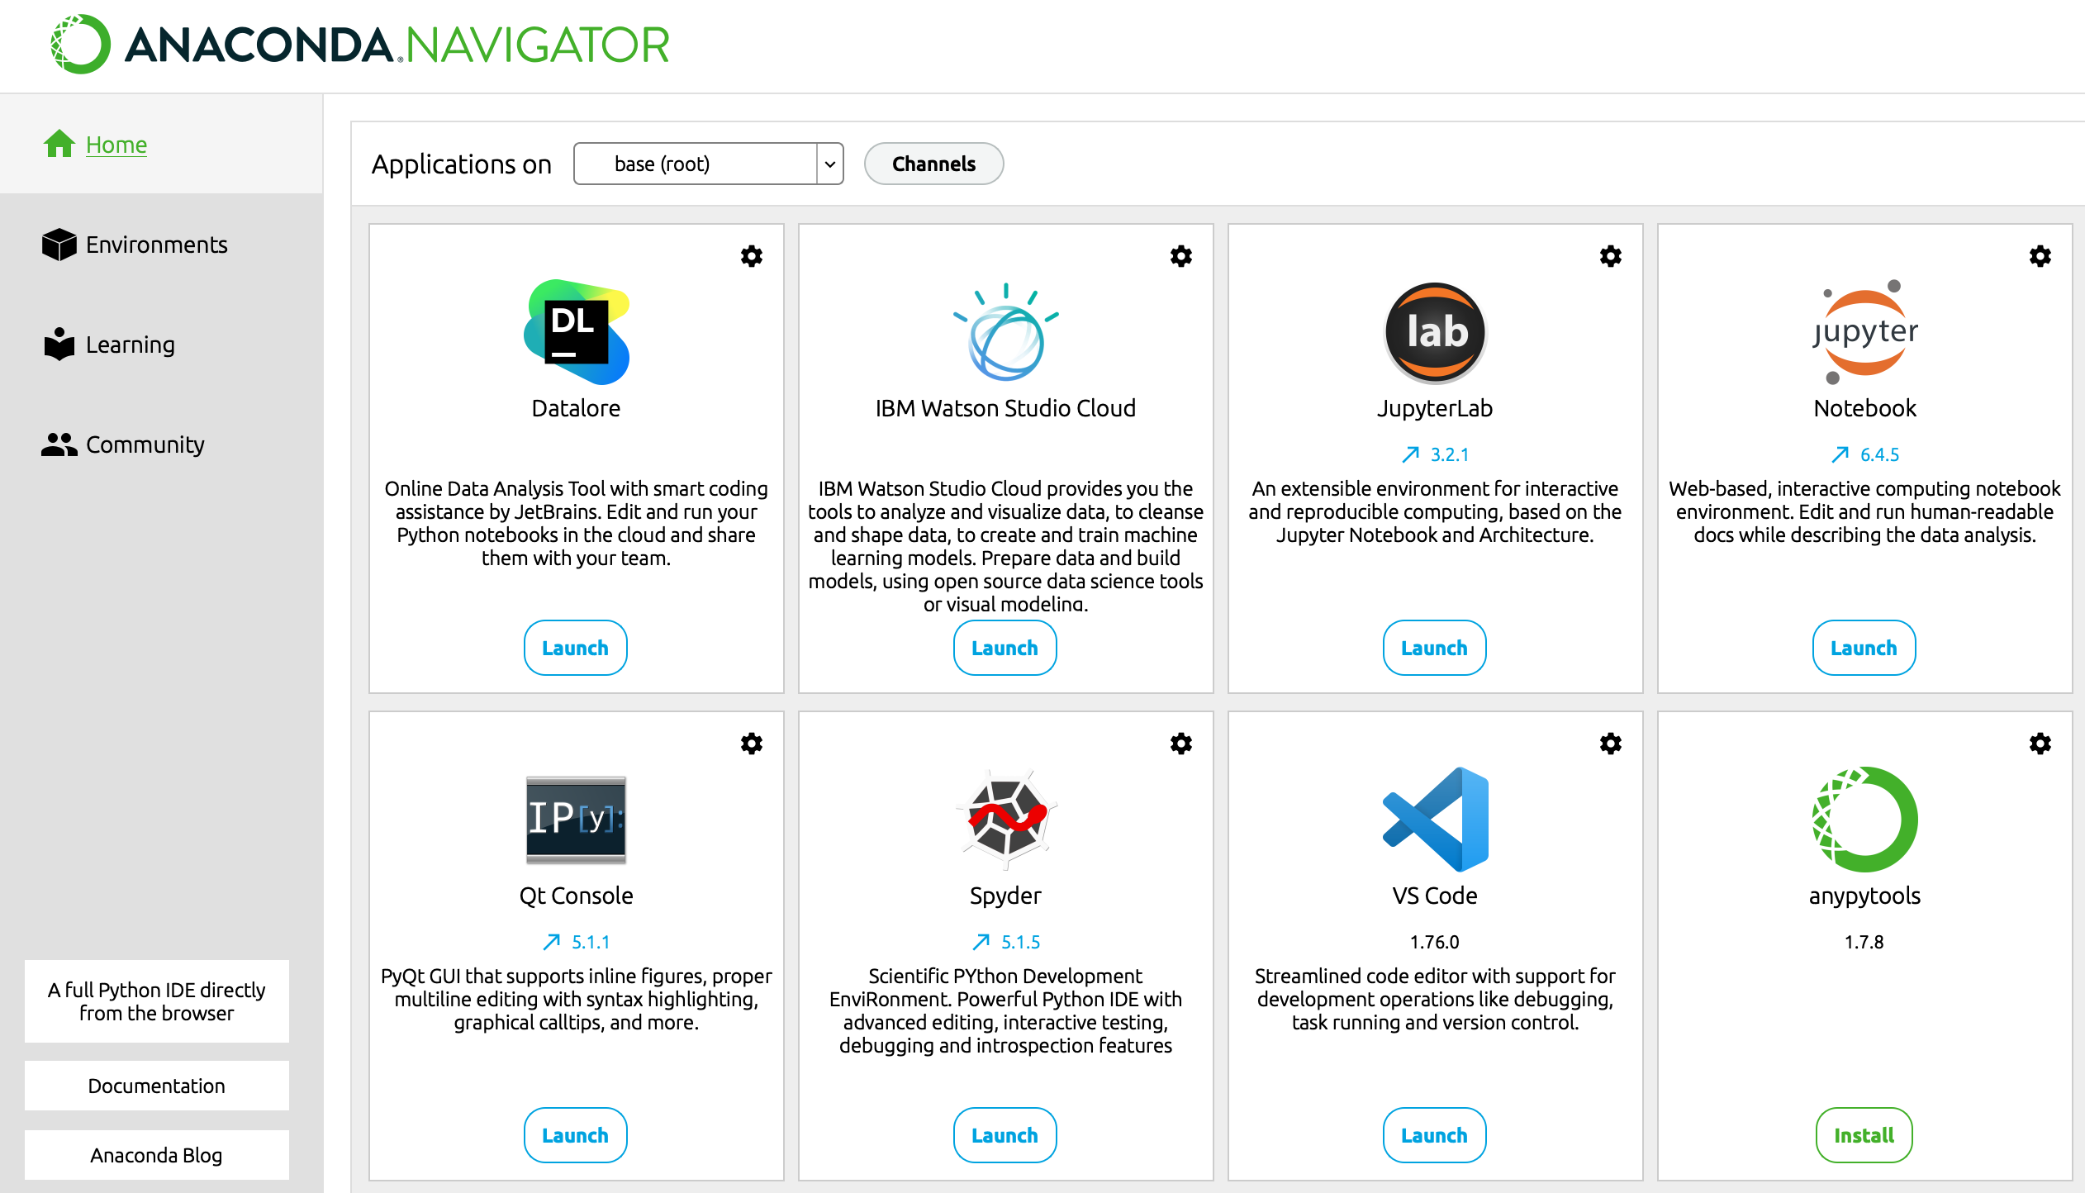
Python for Data Science & AI: Anaconda
https://www.anaconda.com/download
Notes:
https://www.anaconda.com/download

Slide 41
Python for Data Science & AI: Modules Included with Anaconda
Module | Abbreviation | Provides methods for
pandas | pd | Data analysis and visualization
numpy | np | Numerical computing
seaborn | sns | Data visualization
datetime | dt | Working with datetime objects
urllib |  | Getting files from the web
zipfile |  | Working with zip files
sqlite3 |  | Working with a SQLite database
json |  | Working with JSON data
scikit-learn | sklearn | Regression analysis
Notes:
,

Slide 42
Python for Data Science & AI: Two Ways to Install a Module
The conda-forge is a community-driven channel for conda packages that provides many additional packages beyond those available in the default conda channels.
https://docs.conda.io/projects/conda/en/latest/user-guide/concepts/channels.html
Install Pandas from the default channel.
conda install pandas
Install pyreadstat from the conda-forge channel.
conda install --channel conda-forge pyreadstat

Slide 43
Python for Data Science & AI: How to Import Modules
Import one module into the namespace specified by the ‘as’ clause
import pandas as pd
Import one submodule from a module
from urllib import request

Slide 44
Python for Data Science & AI: How to Call Methods
How to call a method in a module
import pandas as pd
polls_url =\ 'http://projects.fivethirtyeight.com/.../president_general_polls_2016.csv' polls = pd.read_csv(poll_url)
How to call a method from a DataFrame object
polls.sort_values('startdate')

Slide 45
Python for Data Science & AI: How to Chain Methods
How to chain the sort_values() and head() methods
# sort the rows of the DataFrame polls in ascending order based on the values in the 'startdate' column and return the first five rows of the resulting DataFrame.
polls.sort_values('startdate').head()
How to chain the query() and plot() methods
polls.query('state != "U.S."') \
.plot(x='startdate', y=['Clinton_pct','Trump_pct'])
Notes:
The df.query() method in pandas filters rows in a DataFrame using a user-friendly, SQL-like boolean string expression. Instead of using complex brackets and repeating the DataFrame's name, you simply pass the filtering conditions as a string. [1, 2, 3, 4]

Slide 46
Python for Data Science & AI: How to Call a Method with Parameters
The signature for the sort_values() method
sort_values(by, axis=0, ascending=True, inplace=False,
kind='quicksort', na_position='last’)
The sort_values() method with positional and keyword parameters
polls.sort_values('startdate', ascending=False, inplace=True)

Slide 47
Python for Data Science & AI: The Syntax for List, Slice, Tuple, and Dictionary
A list is a sequence of items within brackets
[item1,item2,...]
A tuple is coded like a list, but in parentheses
(item1,item2,...)
A dictionary is a sequence of key/value pairs within braces
{key1:value1, key2:value2, ...}
A slice sets the start and stop values and an optional step value
start:stop:step

Slide 48
Python for Data Science & AI: Using List, Slice, Tuple, and Dictionary
A list used as a keyword parameter
polls.drop(columns=['cycle','branch','matchup','forecastdate'],
inplace=True)
A tuple used as a keyword parameter
polls.plot.line(xlim=('2016-06','2016-11’))
A dictionary used as a keyword parameter
polls.rename(columns={'adjpoll_clinton':'Clinton',
'adjpoll_trump':'Trump’})
Two slices used in a loc[ ] accessor
polls.loc[0:100:10,'state':'grade']
Notes:
"inplace" operation modifies the original data.
The expression polls.loc[0:100:10,'state':'grade'] extracts a specific grid of data from a pandas DataFrame. It grabs rows starting at index 0 up to 100, stepping every 10th row, and slices all columns from state to grade (inclusive)

Slide 49
Python for Data Science & AI: Coding a List Comprehension
The syntax
[expression for member in iterable]
A list comprehension is used to provide the list for a keyword parameter
xticks = [x for x in range(1900,1920,2)]
The resulting list
[1900, 1902, 1904, 1906, 1908, 1910, 1912, 1914, 1916, 1918]
Notes:
syntax refers to the strict set of rules that define how symbols, punctuation, keywords, and words must be structured and arranged to form a valid program. Essentially, it acts as the grammar of a programming language

Slide 50
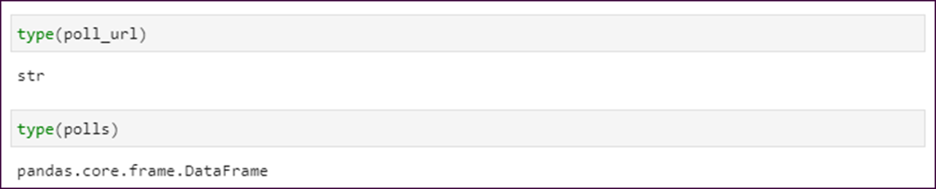
Python for Data Science & AI: The Type Function
How to use the Python type() function to check the data type of a variable

Slide 51
Python for Data Science & AI: Two Ways to Continue a Statement
With implicit continuation
polls.sort_values(
['state','startdate'],
ascending=False,
inplace=True)
With explicit continuation
polls.sort_values(['state','startdate'], \
ascending=False, \
inplace=True)
Notes:
There is no functional difference in how the code executes.
The only difference is readability and Python syntax:
Implicit continuation: Uses Python's built-in rule that any code inside parentheses ( ) can span multiple lines automatically.
Explicit continuation: Uses the backslash \ as a manual line-continuation character.
For cleaner and more standard code, the implicit continuation (without \) is highly recommended in Python and Pandas.

Slide 52
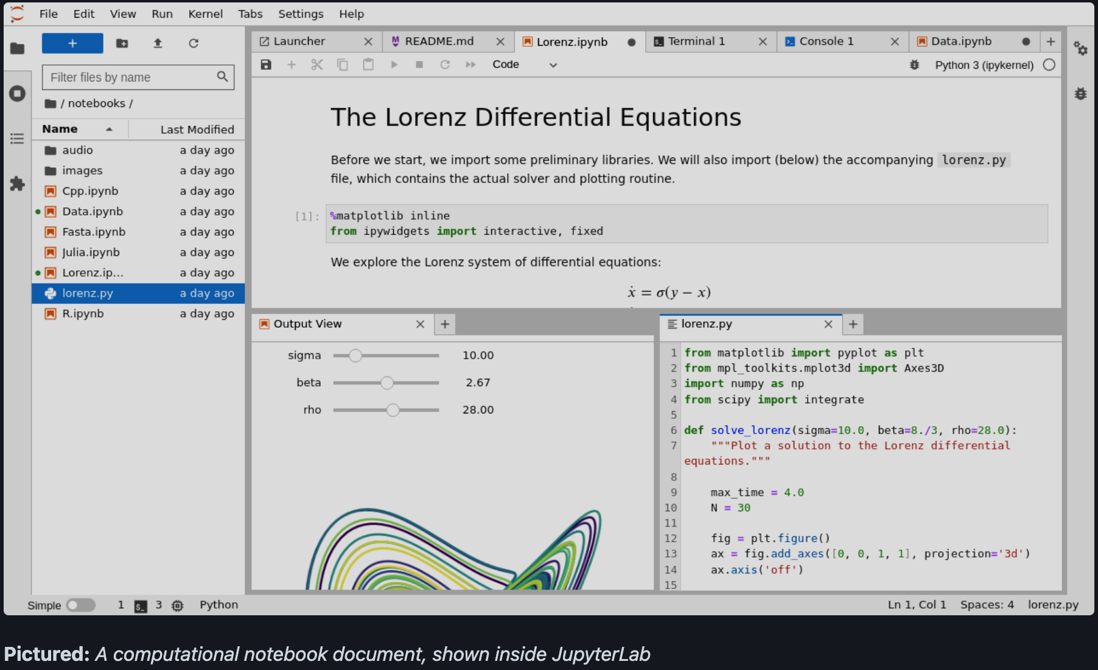

JupyterLab

Slide 53
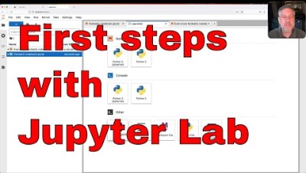
JupyterLab: A Quick Intro

Slide 54
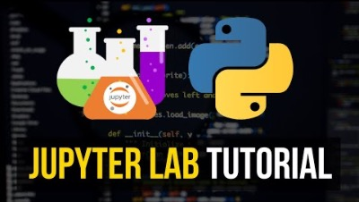
JupyterLab: Tutorial

Slide 55

Upload Files

Slide 56
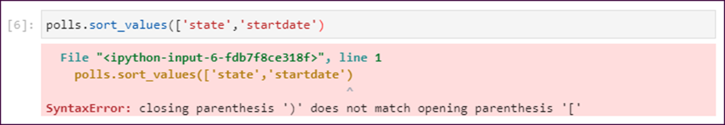
Syntax Error
A syntax error occurs when the interpreter cannot parse the code due to invalid syntax. This means that the code violates the language grammar rules, which results in an error message.
Syntax errors can occur for a variety of reasons, such as a missing or misplaced punctuation mark, an incorrect keyword or function name, or a mismatched set of parentheses or brackets.
A syntax error in a Notebook

Slide 57
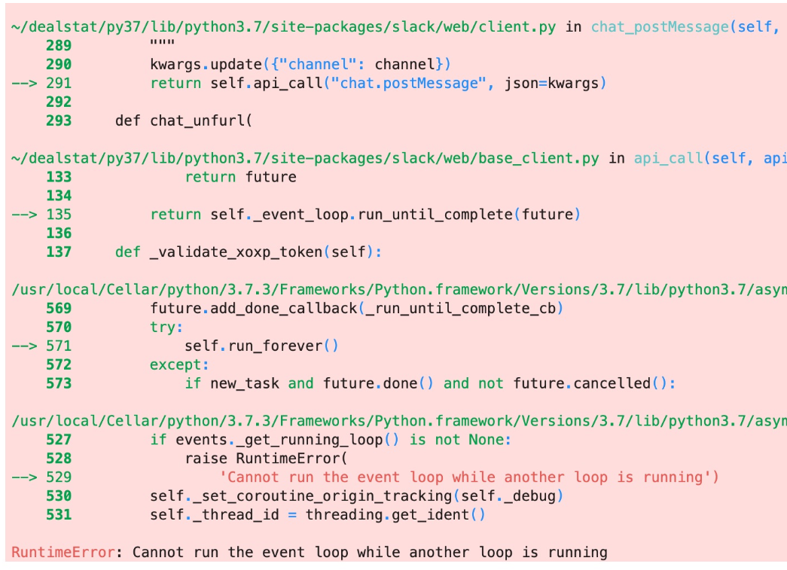
Runtime Error
A runtime error in a Notebook
A runtime error occurs when the code is syntactically correct, but an error occurs during the execution of the code. This can happen for a variety of reasons, such as trying to perform an illegal operation, attempting to divide by zero, or accessing an undefined variable.
Runtime errors are also known as exceptions, and when they occur, Python will usually raise an exception and stop the program's execution. The exception message will provide information about what went wrong and where the error occurred, allowing you to identify and fix the issue.

Slide 58
References
Data science from scratch: first principles with Python, Joel Grus, O'Reilly Media, 2019
Python for Data Analysis: Data Wrangling with Pandas, NumPy, and IPython, Wes McKinney, O'Reilly Media, 3rd edition, 2022.
Python Data Science Handbook: Essential Tools for Working with Data, Jake Vanderplas, O'Reilly Media, 2022
Murach’s Python for Data Analysis, Scott McCoy, Mike Murach & Associates, Incorporated, 2021.
Intro to Python for Computer Science and Data Science: Learning to Program with AI, Big Data and The Cloud, Paul Deitel, Pearson Education Limited, 2021.
Artificial Intelligence: a Modern Approach, Global Edition, Stuart Russell , and Peter Norvig, Pearson Education, 2021.

Slide 59

End of lecture …

